Slide 1
Interactive Data Exploration And Analytics
Radhika Bisht 829299
Chenhan Ma 823289
Martin David Valentino 825178
Yanan Wang 789495

Slide 2
Outline
Introduction of Interactive Data Exploration
Benefits of Interactively Explore and Analyze Data
Major Approaches and Applications in Interactive Data Exploration
Open Problems and Challenges
Conclusion

Slide 3
Introduction to Interactive Data Exploration and Analytics
Exponentially increase of data over the past decades.
Huge masses of complex, high dimensional data sets from diverse sources.
Traditional DBMS:
Static,
Simple Query in large data set,
Numerous assumptions about the workload.
Interactive Data Exploration:
Involve User interaction,
Iterative query,
Highly ad hoc process,
Visualization.

Slide 4
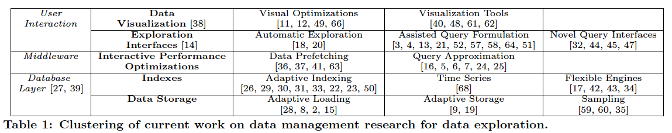
Introduction
Why is IDE important?
Provide online results on numerous data
Provide accurate results
Aim:
Balance the trade-off between collecting all relevant information and reduce the size of returned data
Visualize the relevant patterns of the data
Facets of Data exploration
1. User interaction tools
2. Middleware
3. Redesign database architecture

Slide 5
Introduction
Three steps in interactive data exploration:
①
③
Processing numerous selection queries with iteratively varying selection predicates
Adjusting accordingly the selection query for the next iteration.
Reviewing returned objects (i.e., trials) and classifying them to relevant and irrelevant
②

Slide 6
Benefits of IDE
Traditional Data Mining
The process of extracting useful information from large data sets
Emphasize some combination of machine learning, statistics and DBMS
Drawback: computationally demanding and time consuming
Interactive Data Mining
Emphasize interactivity and effective integration
Benefit
The flexibility, creativity and general knowledge of a human can be involved
The best of the different but related domains can be combined ➔ the sum is greater than the parts

Slide 7
Benefits of IDE (Contd.)
Data Visualization
One of the most general and the least complicated IDE technique
Easy to use by non-expert users
Provide significant and intuitive information
Users can be involved in the critical steps to improve the discovery process
GNoT

Slide 8
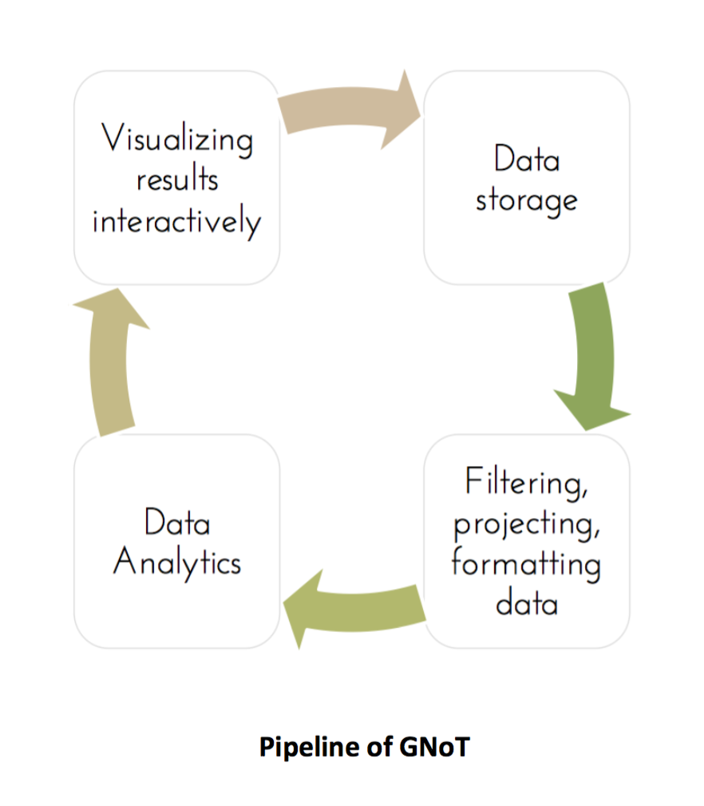
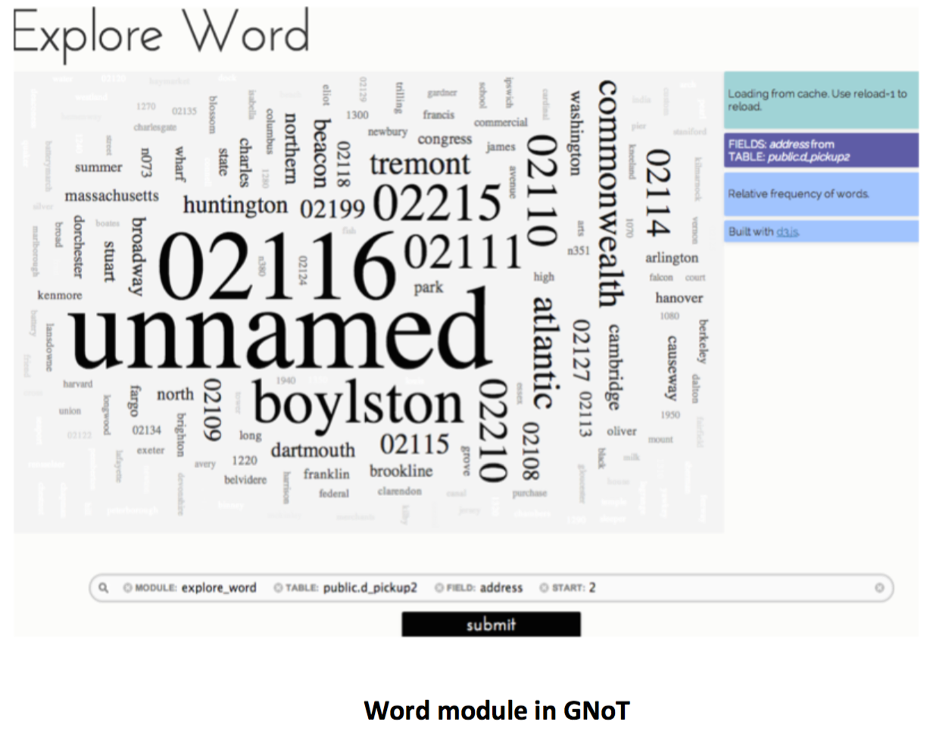
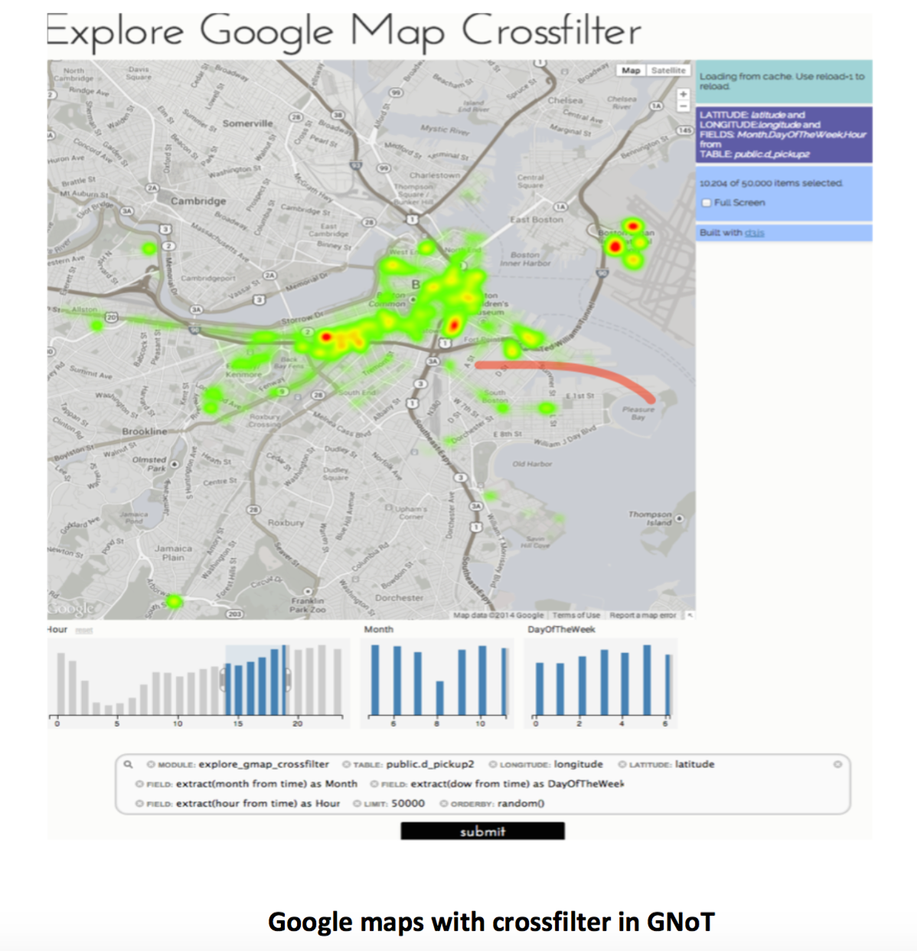
Benefits of IDE (Contd.)
GNoT
A visual data mining framework
Combine data visualization and data analysis tools
Using GNoT

Slide 9
IDE Application and Approaches
Pattern Mining Approaches
Use pattern mining to enable the discovery of patterns from data.
Advantages:
Patterns are Interpretable representations and can thus provide explanation
Patterns can be used for many well-known data mining tasks
Example of this approach:
Markov Chain Monte Carlo (MCMC) based technique
Interactive Subgroup Discovery
SIREN – A system for visual and interactive mining of geospatial redescriptions.

Slide 10
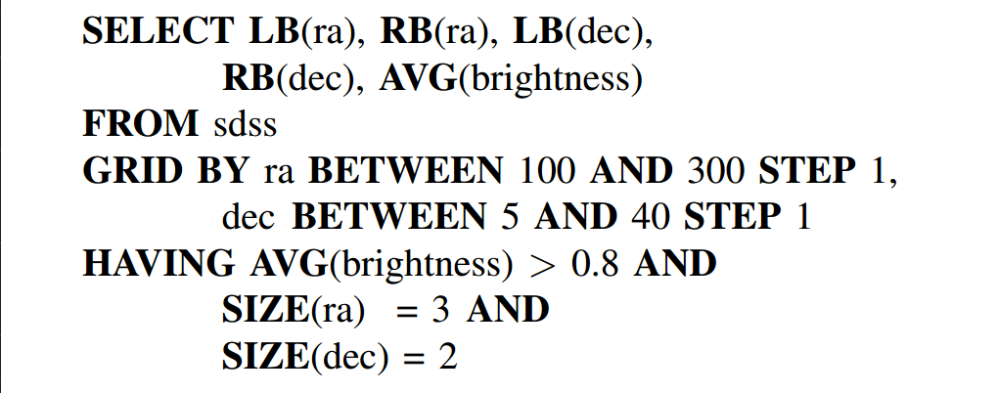
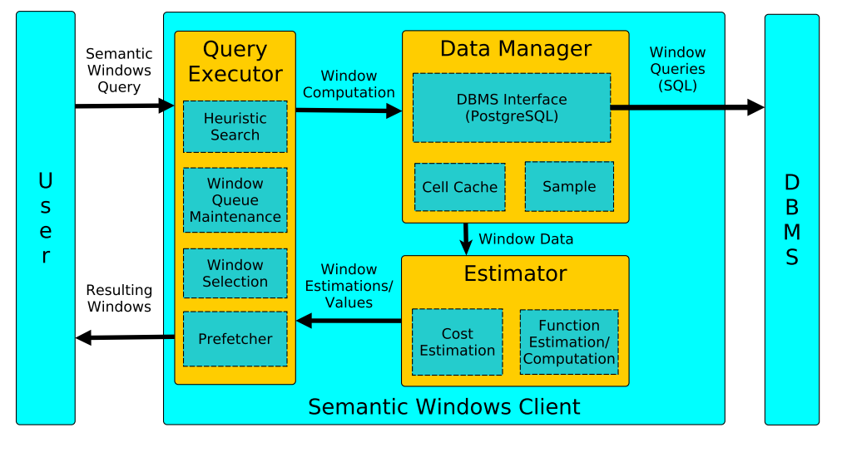
IDE Application and Approaches (Contd.)
Semantic Windows Approaches
An extension over existing DBMS technology (PostgreSQL)
An example of an SW query written with the proposed SQL
extensions
SW design as a layer on top of PostgreSQL

Slide 11
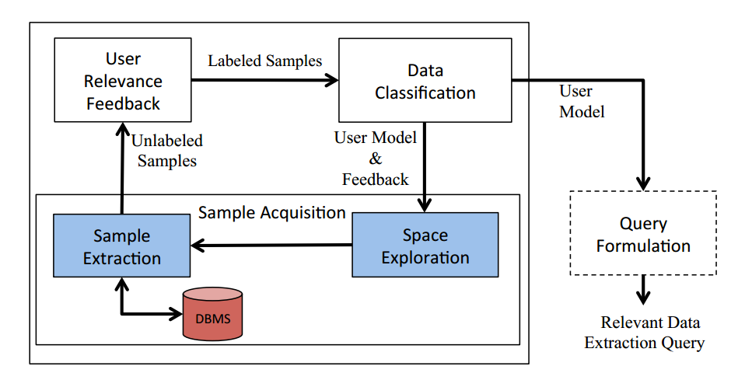
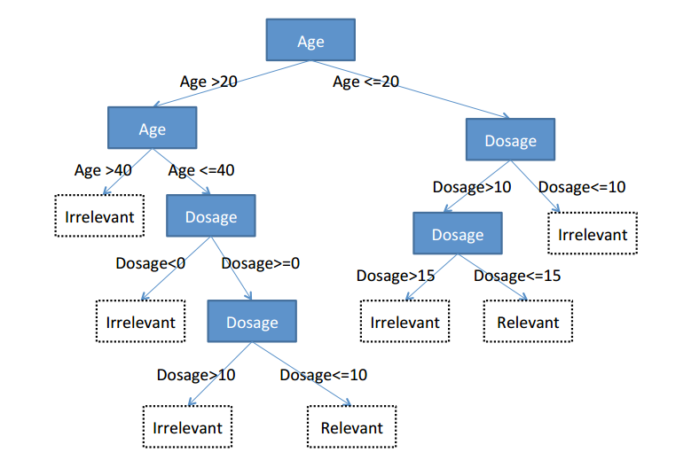
IDE Application and Approaches (Contd.)
AIDE (Automated Interactive Data Exploration)
AIDE Framework
An example decision tree

Slide 12
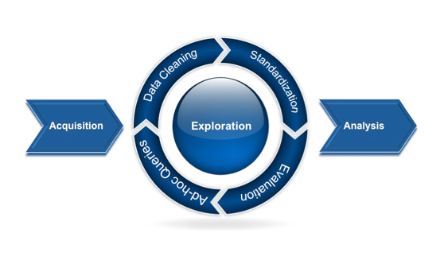
CHALLENGES & OPEN PROBLEMS
Big Data is not just big:
Gartner- the research firm describes it as” high-variety, high-velocity, and high volume information assets, but managing these assets to derive the fourth “V” – value – is a big time challenge.

Slide 13
Application based challenges
AIDE:-
- Need an online fashion the example objects to be extracted by the user.
- High requirements to achieve desirable interactive experience.
Pattern Mining:-
- Developing principled methods that allow user- and task-specific information to be taken into account.
- Need principled evaluation of exploratory data mining results.
Semantic Windows Approaches: -
- Complex and hard to optimize.
- Aggregation at beginning, blocked until all computed.
- Not able to output online results.

Slide 14
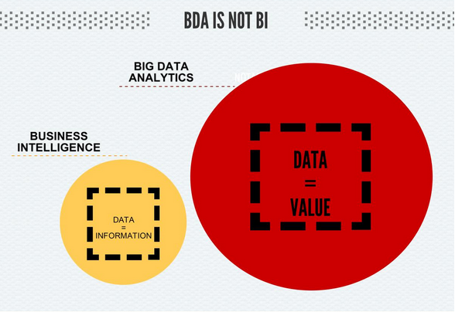
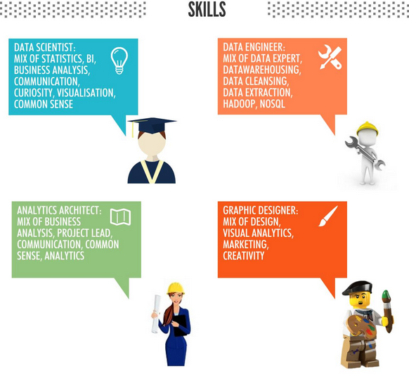
General Problems
The Practical Issues of Storing All the Data
Dealing with the Security Issues
Handling various sources of data available
The time it takes to glean value out of data
Finding the right resources and skills
Standardization/protocol challenge
Future directions:
Process past user interaction histories to predict exploration trajectories and identify interesting exploration patterns.
Reconsider data and storage patterns.

Slide 15
Conclusion
Traditional DBMS:
Can’t deal with large dataset to efficiently find relevant pattern.
Doesn’t support interactive operations and exploratory queries.
IDE emphasizes visualization on interested data, human interactivities and effective integration.
Example applications in IDE includes: Semantic Windows approaches, Pattern mining and a usage of AIDE framework, which are aiming to provide better experience for doing data exploration process.
High level human interaction is required in IDE and related fields. Still lack declarative exploration languages.

Slide 16
References
[1] Matthijs van Leeuwen. Interactive Data Explorationusing Pattern Mining.
[2] Alexander Kalinin, Ugur Cetintemel and Stan Zdonik. Interactive Data Exploration UsingSemantic Windows.
[3] Kyriaki Dimitriadou, Olga Papaemmanouil and Yanlei Diao. AIDE: An Automated Sample-based Approachfor Interactive Data Exploration.
[4] Stratos Idreos, Olga Papaemmanouil, Surajit Chaudhuri. Overview of Data Exploration Techniques.
[5] Andreas Holzinger. Introduction to the special issue on ‘‘interactive data analysis’’
[6] L ANSELIN. Interactive techniques and exploratoryspatial data analysis.

